Slide 1





Group PL3 presentation
Statistics and Data Science in Practice
Kanbar, M. (Mikdad)
Li, X. (Xiang)
Du, J. (Jinrui)
Song, J. (Jia)
08/01/2024

Slide 2
●●●●●●
●●●●●●
●●●●●●
●●●●●●
CONTENT
01
Working Experience
02
Part2
03
Model
04
Academia vs Industry

Slide 3
Biometric Research
Phenotype, Genotype
Photosynthesis

Slide 4
Working Experience
PART.1

Slide 5

Working Experience
How does a typical day look like for a researcher?
Achieving Goals Through Team Collaboration

Slide 6

Working Experience
How to achieving Goals Through Team Collaboration ?
The importance of effective communication within the team
Navigating between operations and innovation

Slide 7
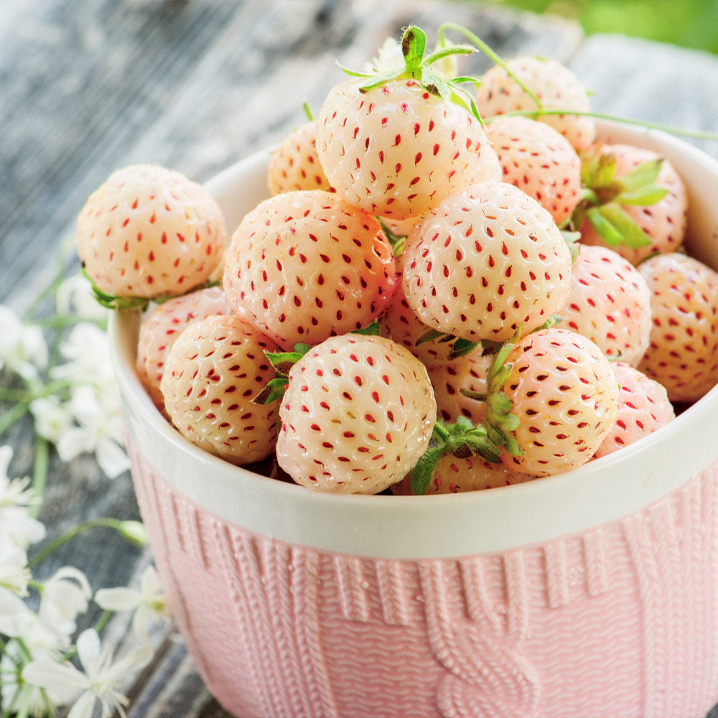
Working Experience
"Statistical Insights Transforming Lives"
Test Hybrid

Slide 8
PART.3
Model

Slide 9
Model Purpose: Prediction
Predict what?
Which material/hybrid can be a good commercial variety.
Why predict?
Biological trails take a couple of years.
Genetic space is huge and narrow down trails to a small amount.

Slide 10
Model Purpose: Prediction
Challenge?
Small data: Number of experiment is small.
Time is limited and money is limited.

Slide 11
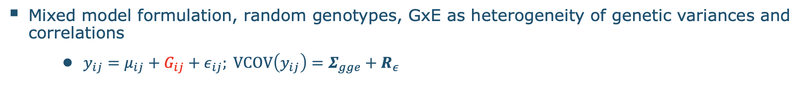
Challenge in Model: Random Effects & Modeling Correlation
01
02
From where?
How to solve?
Genetic samples from highly related individuals
Mixed model framework

Slide 12
Challenge in Model: Diversity of Responses
Continuous Variable | Discrete Variable
- | Dummy Variable
- | Counting Variable
- | Category

Slide 13
Challenge in Model: Efficiency & Good Solution
Hard Trade-off
Simple model
Complex model
Efficiency
Good solution

Slide 14
Academia
vs
Industry
PART.4

Slide 15
Academia vs Industry
Years of experience in both :
First academia, and then made the transition to industry, any differences ?
Not so many differences, because already was on the applied side in the university ( personal situation ).
> Did a lot of publishing as an author. Now a lot of reading.
> Slight differences with respect to priorities.

Slide 16
Academia vs Industry
Communication
In academia : explaining things to other researchers.
In industry : might be difficult because we expect more people with different backgrounds.
Communication is still there!
Visualization :
Work with people who have the right skills to build attractive, efficient and user-friendly dashboards.
Teamwork!

Slide 17
Question for you :
What do you think are the most important skills for a data scientist / statistician ?

Slide 18
Advice for MSc Statistics & Data Science students ?
- Passion ! Love what you are doing.
Domain knowledge :
know what are you doing.
Ask the right questions.
Know the context.
It is not only about crunching numbers!
- Soft skills are not to ignore!

Slide 19
Questions?

Slide 20

Questions?
Q1:
Q2: what challenges did I mention in the model part?
Please list one/two challenges by your own words.

